Slide 1
Employee Data Analysis using Excel
STUDENT NAME:P.PAVITHRAA
REGISTER NO:122201216/9BF1BE57AFF8C0A87B644B3D94654E2B
DEPARTMENT:B.COM CS
COLLEGE:AGURCHAND MANMULL JAIN COLLEGE

Slide 2
PROJECT TITLE
Employee Performance Analysis using Excel

Slide 3


AGENDA
Problem Statement
Project Overview
End Users
Our Solution and Proposition
Dataset Description
Modelling Approach
Results and Discussion
Conclusion
3/21/2024 Annual Review

Slide 4

PROBLEM STATEMENT
Identifying strengths and weaknesses:
Without performance analysis, it is difficult to pinpoint employee strengths and areas needing improvement.
Optimizing productivity:
Ineffective performance management can lead to inefficiencies and misalignment of individual and organizational goals.
Impact on business growth:
Absence of performance analysis may result in decreased morale and missed opportunities for strategic development and growth.

Slide 5

PROJECT OVERVIEW
WHAT IS EMPLOYEE ANALYSIS?
Employee analysis evaluates, and performance, skills, attendance, and engagement.
It identifies strengths and weaknesses of employees.
The goal is to enhance job satisfaction and productivity.
It aligns employee capabilities with organizational objectives.
ANALSIS OF DATA USING EMPLOYEE DATABASE FOR THERE DIFFERENT METRICS
Employee data analysis involves examining various metrics from the employee database to gain insights into performance, attendance, engagement, skills, retention, and compensation.
KEY AREAS INCLUDE:
Performance metrics: Track kpls and goal achievement.
Attendance: Monitor absenteeism and punctuality.
Engagemnet: Review survey results and feedback.
Skills and Training: Assess skills and the impact of training.
Retention: Analyze turnover rates and exit interview data.
Compensation: Evaluate salary and benefits usage.
.

Slide 6

WHO ARE THE END USERS?
HR MANAGERS : Use the data to make decisions on promotions, training, and development.
DEPARTMENT MANAGERS: Assess individual and team performance to optimize workflow and productivity.
EXECUTIVES: Utilize insights to align performance with organizational goals and strategy.
EMPLOYEES: Benefit from feedback and development plans to improve their own performance.
TRAINING AND DEVELOPMENT TEAMS: Design targeted programs based on identified performance gaps.

Slide 7

OUR SOLUTION AND ITS VALUE PROPOSITION
Filtering:
I used filtering for to find out the missing values in the table.
Conditional formatting:
I used conditional formatting for to find out the blanks in the exit date.
IFS Formula:
I put ifs formula for to find the performance level and I have given rating as well.
Pivot table:
I used a pivot table to summarize the count of first names by business unit, performance level, and gender code.
Charts:
I used to identify which employee categories had the highest counts.
Graphs:
I determined the medium number of employees.

Slide 8
Dataset Description
I used an employee database from kaggle.
The dataset originally had 26 features.
I selected 9 features for analysis.
Employee ID
Gender (Male, Female)
Performance level ( Very high, High, Medium, Low)
Business unit ( CCDR, EW, WBL)
Name ( First Name, Last Name )
Employee status ( Active, Future Star)
Employee Type (Part-time, Full-time, Contract)
Performance Score ( Exceeds, Needs, Improvement, Fully Meets)
Current Performance Rating ( 1 through 5)

Slide 9

THE "WOW" IN OUR SOLUTION
Performance level=IFS (Z8>=5,”VERY HIGH”,Z8>=4,”HIGH”,Z8>=3,“MED”,TRUE,”LOW”)
3/21/2024 Annual Review
9

Slide 10
MODELLING
Data collection:
I gathered data from kaggle and identified the relevant features necessary for my analysis.
Data clearing:
Data cleaning involves identifying and correcting errors or inconsistencies to enhance the quality and accuracy of the data. I identified missing values in the exit date field using conditional formatting and removed blank values through filtering. I also ensured consistency across different datasets.
Techniques:
I converted numerical values into categorical variables. I employed IFS conditions to handle multiple criteria and verified the results across these conditions. Additionally, I assessed performance levels based on the cleaned data.
10

Slide 11
Analysis and Identification :I examined the employee performance data to determine which employee had the highest count in the medium performance categories. Next, I identified the employee with the highest count in the low performance categories. The counts in the very low and very high performance categories were found to be very low.
Chart Creation: I created a chart to visualize this data and titled it "Employee Performance Analysis.
"Trendline Addition: I added a trendline to the chart for the medium performance categories due to their higher counts.

Slide 12
Pivot table setup:
I created a pivot table.
Row and column arrangement:
I placed the business unit in the rows. I placed the performance level in the columns.
Filter application:
I applied gender as a filter.
Value calculation:
For the values, I used the count of first names.
Employee statistics:
The total number of employees is 1,533.
The number of male employees is 668.
The number of female employees is 865.

Slide 13
RESULTS
13

Slide 14
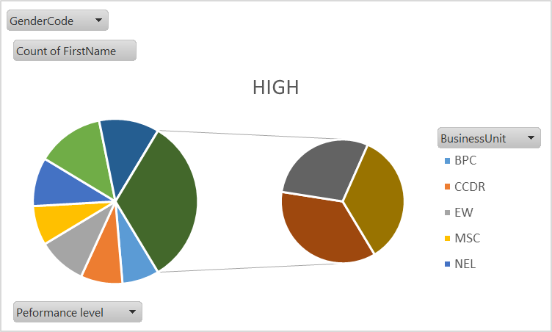

Slide 15
Conclusion
Dataset: Analyzed a Kaggle employee dataset with 9 selected features, including gender, performance level, and business unit.
Data Cleaning: Addressed missing values and inconsistencies using conditional formatting and filtering.
Employee Distribution: Identified 1,533 total employees; 668 males and 865 females.
Performance Analysis: Found medium performance level had the highest count, followed by low, with very high being the least common.
Visualization: Used charts and trendlines to highlight performance trends, focusing on medium performance.

